Slide 1
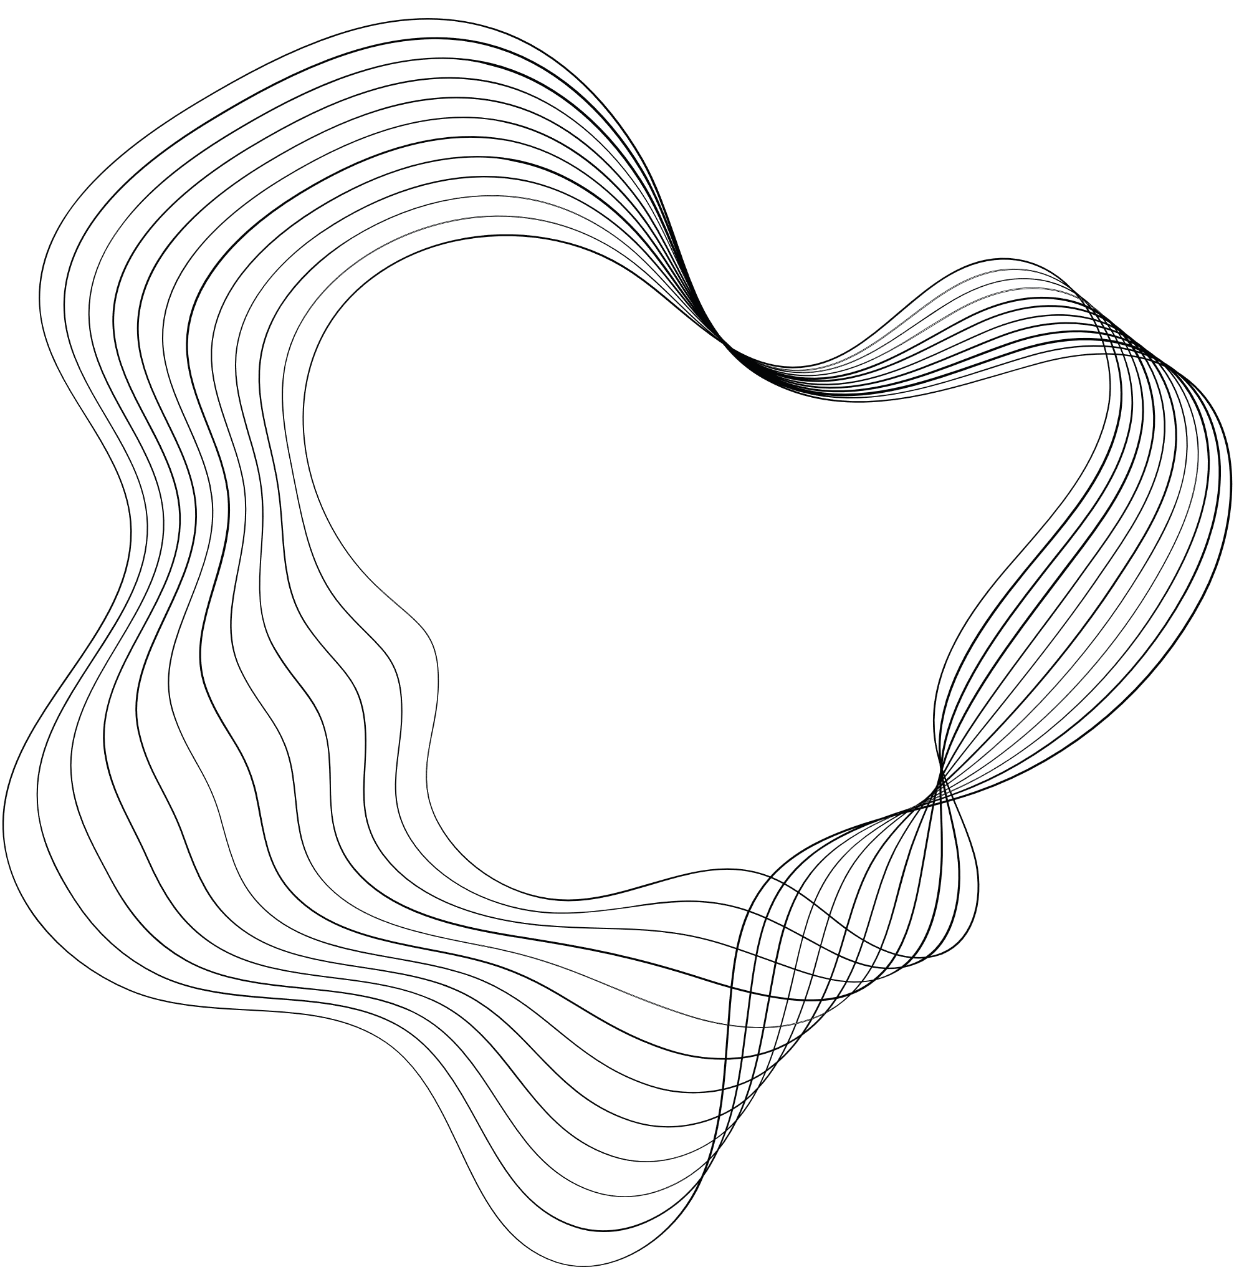

SHRI VISHNU ENGINEERING COLLEGE FOR WOMEN
Department : Computer Science and Engineering
CUSTOMER SEGMENTATION
Project Mentor:
Mrs.K.Soni Sharmila
Team Members:
21B01A0567 - K.S.V.Anjana Sathvika
21B01A0585 - K.Devi Madhumitha
21B01A05B3 - N.Neha
21B01A05C1 - N.Harshita Ganga Bhavani
21B01A05D0 - P.Harika Sahithi

Slide 2
ABSTRACT
In this project our aim is to develop a model that can group the customers based on various characteristics which makes you understand who are the target customers.
There are different types of customer segmentation, such as geographic, demographic, psychographic, and behavioral
Here we will focus on grouping the customers based on demographical character i.e. age, gender, income etc. To accomplish this we will train the model with k-means clustering algorithm.

Slide 3
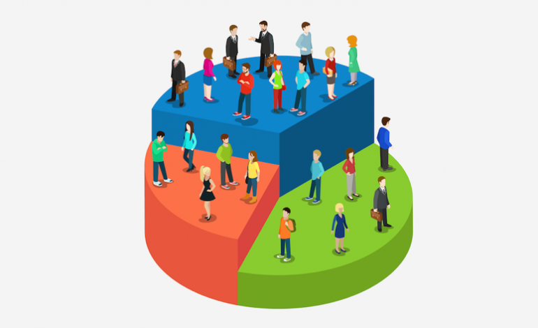

INTRODUCTION
Customer segmentation is a way to divide your customers into groups based on common characteristics.It helps you tailor your marketing, service, and product strategies to different customer needs and preferences

Slide 4
OBJECTIVES
To design more successful products and services : "We prioritize creating customer-focused solutions by understanding their needs and pain points."
To develop effective marketing campaigns : Segmentation tailors marketing by recognizing diverse customer responses to messages.
To offer more relevant customer service : Offering amazing customer service is important if you want to retain customers & grow your business.
To use resources most effectively : Segmentation guides focused resource allocation and budget optimization for maximum impact.

Slide 5

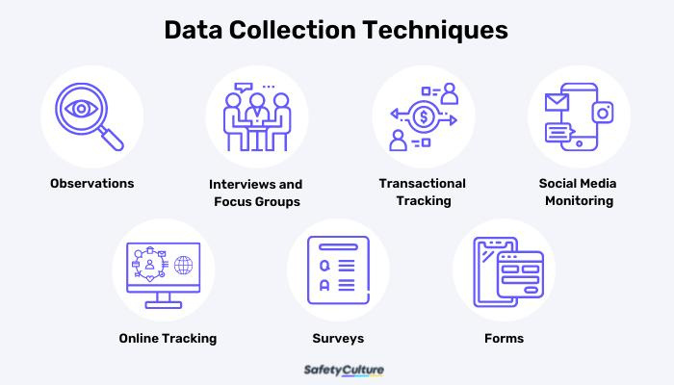
MODULARIZATION :
1. Data Collection :
Surveys are a great way to get data related to demographics, purchasing patterns, preferences, and other distinct categories.
we can also use existing customer data and other data collection methods.
2.Data Preprocessing and Feature Engineering:
Implement functions to clean and preprocess the data like handling missing values and removing duplicates.
Identify the key features and choosing the right attributes.

Slide 6
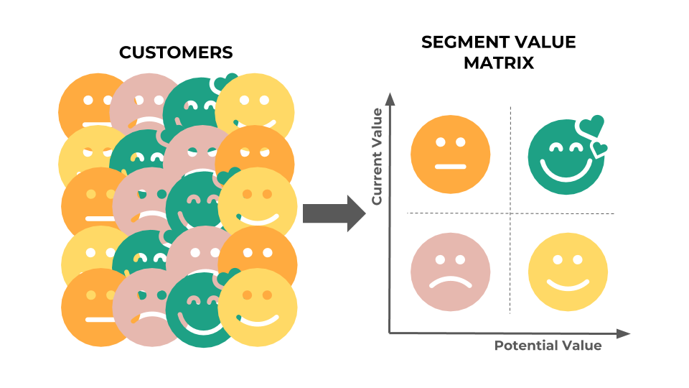
3. Detection of algorithm :
The choice of algorithm depends on factors such as type of data you have, the nature of anomalies
you're looking to detect (outliers,
rare patterns).
• K-Means Clustering
4. Segment Analysis :
Segment analysis is a crucial step in customer segmentation, where you examine the characteristics, behaviors, and preferences of different customer segments.

Slide 7
• By analyzing these segments, businesses can tailor their marketing strategies and offerings to better meet the needs of each group, ultimately improving customer satisfaction and driving better results.
5. Deploying and maintenance :
Model monitoring and maintenance
• Model monitoring
• Feedback loop
• Retraining
Security and Privacy
• Data security
• Model securit

Slide 8
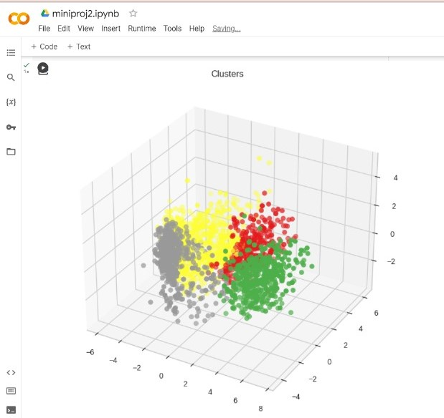
OUTPUT

Slide 9

Existing Work
Customer segmentation used to be done manually but it is not precise
More Time Consuming
Less Accurate
Proposed Work
This project precisely identify customer segments, which is much harder to do manually or with conventional analytical methods.
Ability to process vast amounts of data in real time
Higher accuracy : The value of an optimal number of clusters for given customer data is easy to find using machine learning methods like the elbow method.
To quickly identify new trends and patterns in customer behaviour

Slide 10
CONCLUSION
Our customer segmentation project has built the way for a more customer-centric approach to the business.
By understanding the unique needs and preferences of different customer segments, the market will be ready to deliver more personalized experiences, allocate resources wisely, and ultimately, promote stronger customer relationships.
This project sets the foundation for sustained growth and success in our ever-evolving market.

Slide 11

THANK YOU

